Slide 1

The Cybersecurity Cube: Understanding the CIA Triad, Data States, and Security Frameworks
Week 2
Semester 1, 2025
Dr. Farshid Keivanian

Slide 2

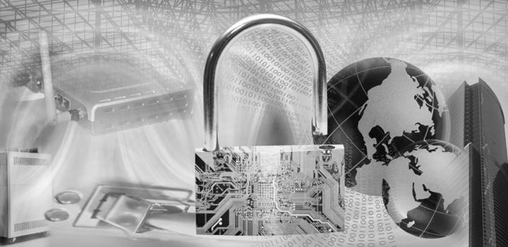
ITEC614 Introduction to Cyber Security
The Cyber Security Cube
Lecture 2

Slide 3
What Are We Learning This Week?
This week, we will explore key cybersecurity concepts that help protect data and systems from cyber threats. Specifically, we will cover:
The Cybersecurity Cube (McCumber Cube)
The CIA Triad (Confidentiality, Integrity, Availability)
States of Data (Data at Rest, Data in Transit, Data in Use)
Cybersecurity Countermeasures (Ways to protect data)
IT Security Management Frameworks (Industry standards like ISO cybersecurity models)

Slide 4
Unit Overview
Why Is This Important?
At the end of this lecture, you will be able to:
Explain the three dimensions of the Cybersecurity Cube (McCumber Cube)
Understand the CIA Triad – The foundation of cybersecurity
Identify the three states of data and their risks
Recognize different cybersecurity countermeasures used to protect systems
Explore security frameworks like ISO standards used in organizations

Slide 5
Previous Lecture
We have considered:
What is security?
Security goals
Cyberspace, Cybercrime, Cybersecurity
Security risks
Identity theft
Countermeasures

Slide 6
Outline
The Cybersecurity Cube
Describe the three dimensions of the McCumber Cube (Cybersecurity Cube).
CIA TRIAD
Describe the principles of confidentiality, integrity, and availability.
States of Data
Differentiate the three states of data.
Cybersecurity Countermeasures
Compare the types of cybersecurity countermeasures.
IT Security Management Framework
Describe the ISO Cybersecurity Model

Slide 7
Reference
This lecture is based on
CISCO Cybersecurity Essentials v1.0 Chapter 2
We acknowledge that all materials are copyrighted by CISCO

Slide 8
The Three Dimensions of the Cybersecurity Cube

Slide 9
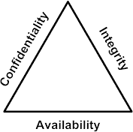
The Three Dimensions
This part will cover the three dimensions of the Cybersecurity Cube:
Security Principles (Confidentiality, Integrity, Availability - CIA Triad)
States of Data (Data at Rest, Data in Transit, Data in Use)
Cybersecurity Safeguards (Technology, Policies & Practices, People)

Slide 10
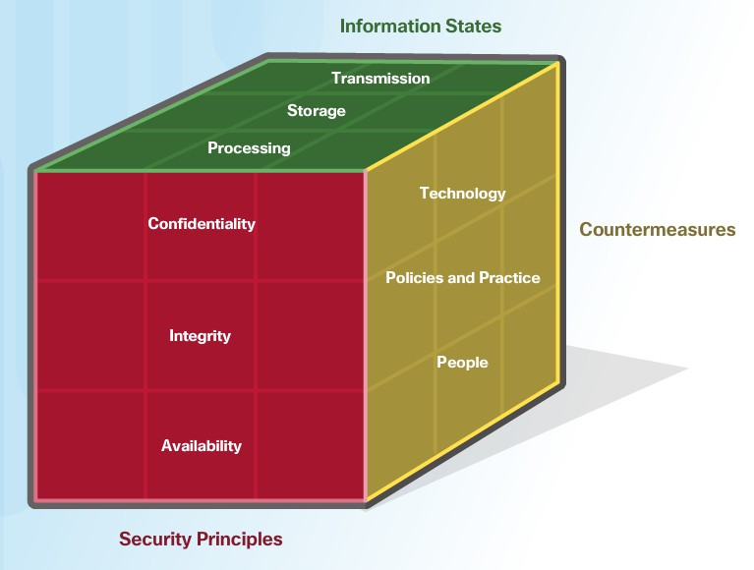
The Three Dimensions (Cont.)
Concept 1: Security Principles (CIA Triad)
Key Points:
The CIA Triad is the foundation of cybersecurity:
Confidentiality – Keeping information private (e.g., passwords, encryption).
Integrity – Ensuring data is correct and unchanged.
Availability – Making sure data is accessible when needed.

Slide 11
The Three Dimensions (Cont.)
Discussion Questions
Can you give an example of a situation where confidentiality, integrity, and availability must all be protected?

Slide 12
The Three Dimensions (Cont.)
Online banking: Customers' financial data must be confidential, transaction records must be accurate (integrity), and the system must be available 24/7 for users.

Slide 13
The Three Dimensions (Cont.)
Discussion Questions
What happens if one part of the CIA Triad fails? (e.g., what if a system is available but lacks confidentiality?)

Slide 14
The Three Dimensions (Cont.)
If a system is available but lacks confidentiality, sensitive data (e.g., personal or financial information) could be exposed to unauthorized users, leading to identity theft or fraud.

Slide 15
The Three Dimensions (Cont.)
Hands-on Activity: Identifying Security Risks
Task: Given different real-world scenarios (e.g., online banking, hospital patient records, university grading system).
Objective: Students must identify which part of the CIA Triad is at risk and propose a solution.

Slide 16
The Three Dimensions (Cont.)
Problem-Solving Question
Your company stores employee salary information. A hacker leaks all salary details online. Which CIA principle is violated, and how should the company respond?

Slide 17
The Three Dimensions (Cont.)
Scenario: A hacker leaks employee salary details online.
CIA Violation: Confidentiality is compromised.
Response: The company should
Investigate the breach source.
Secure the system with stronger access controls.
Notify affected employees.
Take legal action if necessary.

Slide 18
The Three Dimensions (Cont.)
Role-Playing Debate Question
Debate Topic: "Availability is more important than confidentiality in cybersecurity."
Team 1: Argue that availability (keeping systems running) is the top priority.
Team 2: Argue that confidentiality (keeping data secure) is the most important.

Slide 19
The Three Dimensions (Cont.)
Debate Topic: "Availability is more important than confidentiality in cybersecurity."
Team 1 (Pro-Availability): If systems are down, users cannot access services, affecting business operations.
Team 2 (Pro-Confidentiality): If sensitive data is exposed, it can cause long-term damage, including legal consequences and loss of trust.

Slide 20
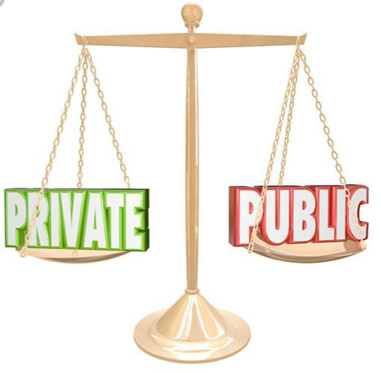
Confidentiality
1. Understanding Confidentiality
Confidentiality means protecting information from unauthorized access.
It ensures sensitive data is only accessible to those who have permission.
It is closely related to privacy.

Slide 21
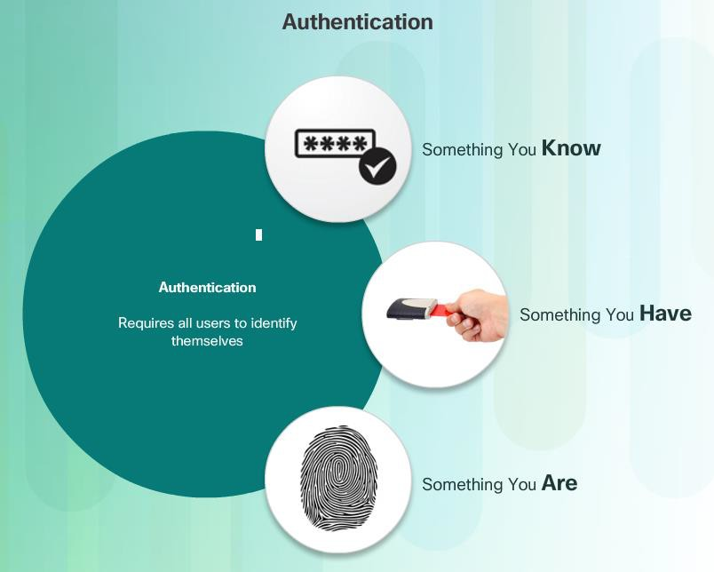
Confidentiality (Cont.)
2. Why Confidentiality Matters?
Protects personal and business data.
Prevents identity theft and fraud.
Ensures trust in organizations.

Slide 22
Confidentiality (Cont.)
3. Methods to Ensure Confidentiality
Encryption: Converts data into a secret code to prevent unauthorized access.
Authentication: Users prove their identity using passwords, biometrics, or security tokens.
Access Control: Limits who can view or modify data.

Slide 23
Confidentiality (Cont.)
4. Privacy vs. Confidentiality
Privacy: Deals with how data is collected and used.
Confidentiality: Ensures data is only accessible to authorized individuals.

Slide 24
Confidentiality (Cont.)
Discussion Questions:
What are some examples of data that require confidentiality?
Examples of confidential data – Personal details (name, address, ID numbers), financial records, medical history, passwords, and business trade secrets.

Slide 25
Confidentiality (Cont.)
Discussion Questions:
How do organizations ensure confidential data is protected?
Protecting confidential data – Organizations use security policies, data access restrictions, encryption, secure storage, and regular audits.

Slide 26
Confidentiality (Cont.)
Discussion Questions:
Why is access control important for confidentiality? How does encryption help in maintaining confidentiality?
Importance of access control – It ensures only authorized users can view or modify data, reducing the risk of leaks or misuse.

Slide 27
Confidentiality (Cont.)
Role of encryption – It converts data into unreadable formats, so even if intercepted, it remains protected without the decryption key.

Slide 28
Confidentiality (Cont.)
Discussion Questions:
What are the differences between privacy and confidentiality?
Privacy vs. Confidentiality – Privacy is about personal control over information, while confidentiality is about protecting shared data from unauthorized access.

Slide 29
Integrity
1. What is Data Integrity?
Data integrity means accuracy, consistency, and trustworthiness of data throughout its lifecycle.
It ensures data is reliable and not altered unintentionally or maliciously.

Slide 30
Integrity
Methods to maintain integrity:
Hashing (ensures data is unchanged)
Validation checks (ensures correct input)
Consistency checks (ensures uniform data)
Access controls (restricts unauthorized changes)

Slide 31
Integrity
Why is Data Integrity Important?
Different organizations have different needs:
Facebook does not verify all user-posted data.
Banks must ensure data accuracy for transactions and accounts.
Data integrity failures can make entire systems unreliable or useless.

Slide 32
Integrity
How Do Integrity Checks Work?
Integrity checks measure data consistency (e.g., checking if a file has changed).
A hash function creates a snapshot of data at a given moment.
If the hash value changes, the data was modified or corrupted.

Slide 33
Integrity
Discussion Questions
Why do some organizations prioritize data integrity more than others?
Banks and healthcare require high integrity for accuracy and security. Social media platforms may focus more on accessibility and user freedom.

Slide 34
Integrity
Discussion Questions
What are some real-world consequences of data integrity failure?
Financial fraud, inaccurate medical records, loss of customer trust, or system failures.

Slide 35
Integrity
Discussion Questions
How do hashing and validation checks prevent integrity issues?
Hashing detects unauthorized changes; validation ensures correct and expected data input.

Slide 36
Integrity
Hashing Activity:
Use an online hashing tool (e.g., SHA-256 generator) to generate hash values for different texts.
Modify the text slightly and observe how the hash changes.
https://codebeautify.org/sha256-hash-generator
Key takeaway: Even small changes completely alter hash values, ensuring integrity.

Slide 37
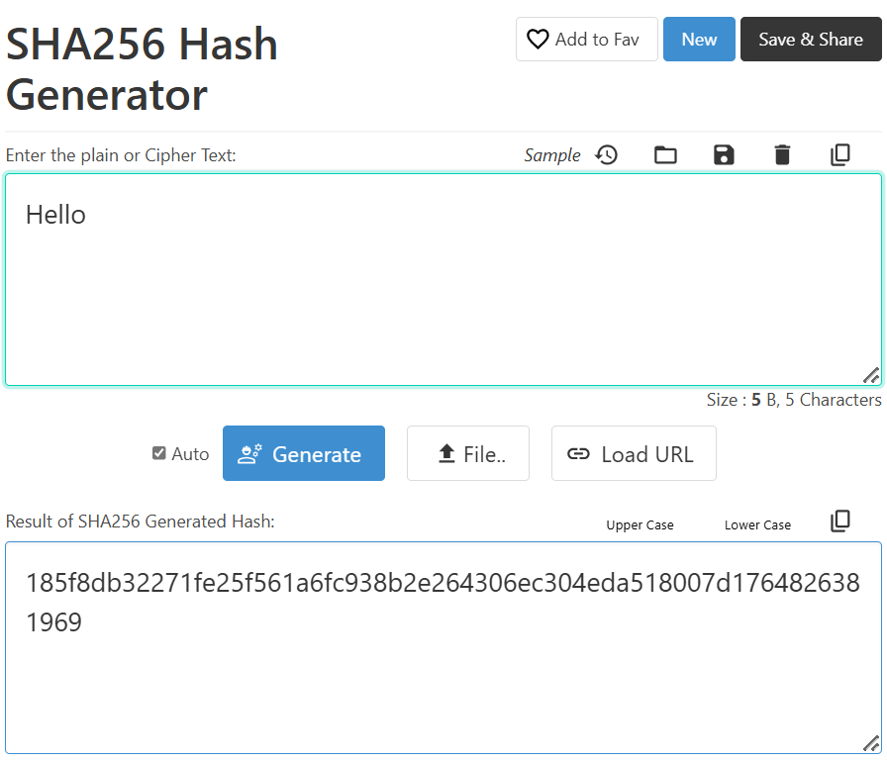
Integrity
Key takeaway: Even small changes completely alter hash values, ensuring integrity.

Slide 38
Integrity
Problem-Solving Question:
Scenario: A company detects that some employee salaries in its database have changed without approval.
Q1: What steps should they take to verify the integrity of their data?
Response: Check database logs, compare with backup data, use hashing to verify records.

Slide 39
Integrity
Problem-Solving Question:
Scenario: A company detects that some employee salaries in its database have changed without approval.
Q2: What measures can they implement to prevent unauthorized modifications?
Response: Implement role-based access control, encryption, and periodic audits.

Slide 40
Integrity
Role-Playing Debate Questions
Should social media platforms verify all user data for integrity?
Pro: Prevents misinformation, improves credibility.
Con: Limits free speech, increases operational costs.

Slide 41
Integrity
Role-Playing Debate Questions
Should banks use blockchain for integrity checks?
Pro: Provides an immutable ledger, enhances security.
Con: High computational costs, regulatory challenges

Slide 42
Data Availability
What is Data Availability?
Data availability means ensuring information systems and services are accessible at all times.
Cyberattacks, hardware failures, and system crashes can disrupt access.

Slide 43
Data Availability
How Do We Ensure Availability?
Key methods:
System redundancy – Having backup systems in place.
Regular backups – Ensuring data recovery in case of failure.
Equipment maintenance – Preventing hardware issues.
Software updates – Keeping systems secure and efficient.
Disaster recovery plans – Preparing for unexpected failures.

Slide 44
Data Availability
Principles of High Availability
Eliminating single points of failure – No critical system should depend on a single component.
Reliable crossover – Smooth switching to backup systems when needed.
Failure detection – Monitoring for issues and fixing them quickly.

Slide 45
Data Availability
Key Strategies for Organizations
Maintain equipment – Prevent hardware failures.
Update operating systems – Fix vulnerabilities and improve security.
Test backups – Ensure recovery is possible.
Plan for disasters – Have clear steps for recovery.
Use new technologies – Improve system resilience.
Monitor for threats – Detect attacks or failures early.
Verify system availability – Test uptime regularly.

Slide 46
Data Availability
Discussion Questions
Why is data availability important for businesses?
It ensures smooth operations, customer trust, and prevents financial loss.

Slide 47
Data Availability
Discussion Questions
What could happen if a hospital’s data system becomes unavailable?
Delayed treatments, misdiagnosis, and even life-threatening situations.

Slide 48
Data Availability
Discussion Questions
How do backups contribute to data availability?
They provide a way to recover lost or corrupted data quickly.

Slide 49
Data Availability
Problem-Solving Question
Scenario: A retail company experiences a server crash on Black Friday, causing a major outage.
Q1: What steps should they take immediately to restore services?
Response: Use backup servers, check logs for errors, and verify system integrity.

Slide 50
Data Availability
Q2: What long-term strategies should they implement to avoid future crashes?
Response: Increase server capacity, use cloud-based redundancy, and schedule regular maintenance.

Slide 51
Data Availability
Role-Playing Debate Questions
Should businesses invest heavily in backup systems, even if they are rarely needed?
Response:
Pro: Prevents downtime, protects revenue, and ensures reliability.
Con: Expensive, may not always be necessary for small businesses.

Slide 52
Data Availability
Role-Playing Debate Questions
Is cloud computing the best solution for ensuring data availability?
Response:
Pro: Scalable, automatic backups, easy access from anywhere.
Con: Security risks, dependence on internet connection.

Slide 53
States of Data
Data exists in three states: At Rest, In Transit, and In Process. Each state requires protection to ensure confidentiality, integrity, and availability.
Data at Rest – Stored data that is not actively moving (e.g., files on a hard drive, database records). Security measures: encryption, backups, access controls.

Slide 54
States of Data
Data in Transit – Data being transferred between devices (e.g., emails, network traffic). Protection methods: encryption, VPNs, secure protocols.
Data in Process – Data actively being used or modified (e.g., calculations in RAM, online transactions). Risks include unauthorized changes, malware, and processing errors.

Slide 55
States of Data
Discussion Questions
Why does data at rest need strong encryption?
Prevents unauthorized access if storage is stolen or hacked.

Slide 56
States of Data
Discussion Questions
What are the risks of sending unencrypted data over a public Wi-Fi network?
Hackers can intercept and steal sensitive information.

Slide 57
States of Data
Discussion Questions
How can organizations prevent unauthorized modifications to data in process?
Use access controls, logging, and validation mechanisms.

Slide 58
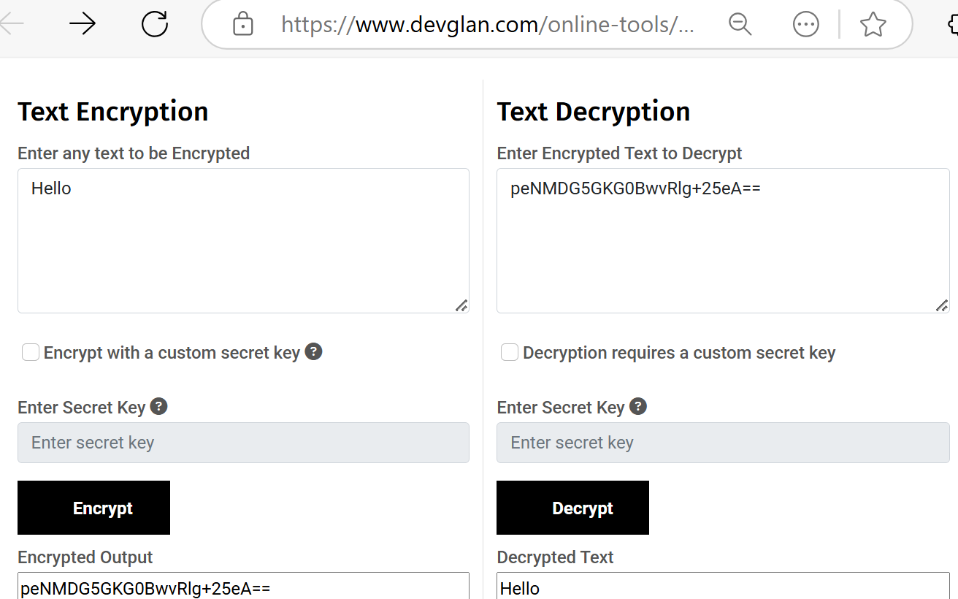
States of Data
Hands-On Activities
Data Encryption Demo:
Encrypt a text file using a basic encryption tool, then decrypt it.
https://www.devglan.com/online-tools/text-encryption-decryption?
Key takeaway: Encryption protects data at rest and in transit

Slide 59
States of Data
Problem-Solving Question
Scenario: A company transfers customer payment data over the internet. Their system lacks encryption.
Q1: What security risks does this pose?
Response: Hackers can intercept and steal payment details.

Slide 60
States of Data
Problem-Solving Question
Scenario: A company transfers customer payment data over the internet. Their system lacks encryption.
Q2: What steps should the company take?
Response: Implement SSL/TLS encryption, use a secure payment gateway, and monitor traffic for threats.

Slide 61
States of Data
Role-Playing Debate Questions
Should companies prioritize protecting data at rest over data in transit?
Pro: Stored data is a long-term target for hackers.
Con: Data in transit is more vulnerable to interception.

Slide 62
States of Data
Role-Playing Debate Questions
Should governments enforce strict laws on data encryption for all businesses?
Pro: Protects user privacy and prevents data breaches.
Con: Increases costs and limits accessibility for smaller businesses.

Slide 63
Cyber Security Countermeasures

Slide 64
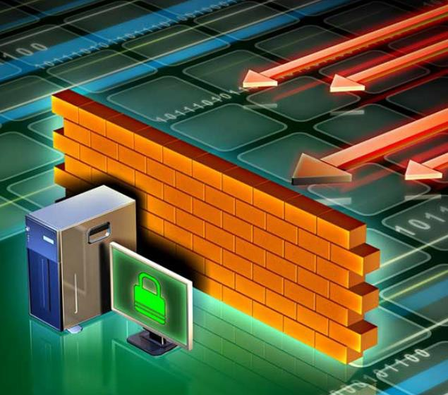
Cybersecurity Technologies and Policies
Technology Safeguards – Security measures include software-based (e.g., antivirus, firewalls), hardware-based (e.g., intrusion detection systems), network-based (e.g., VPNs, access controls), and cloud-based (e.g., SaaS, IaaS) to protect digital assets.

Slide 65
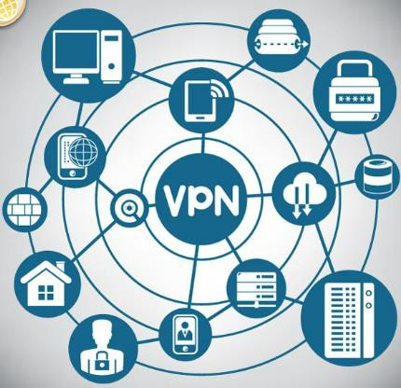
Cybersecurity Technologies and Policies
Cybersecurity Training – Security awareness programs help employees recognize threats and follow best practices, reducing human errors in security breaches.

Slide 66

Cybersecurity Technologies and Policies
Policies and Procedures – Organizations implement policies, standards, guidelines, and procedures to enforce security rules, maintain compliance, and protect sensitive data.

Slide 67
Cybersecurity Technologies and Policies
Discussion Questions
Why are both hardware and software safeguards necessary for cybersecurity?
Software protects against digital threats, while hardware enhances physical and network security.

Slide 68
Cybersecurity Technologies and Policies
Discussion Questions
What risks do companies face if employees are not trained in cybersecurity?
Phishing attacks, data breaches, and accidental exposure of confidential information.

Slide 69
Cybersecurity Technologies and Policies
Discussion Questions
How do policies help organizations stay secure?
They set clear security rules, ensure compliance, and prevent security gaps.

Slide 70
Cybersecurity Technologies and Policies
Problem-Solving Question
Scenario: A company has weak network security, leading to frequent cyberattacks.
Q1: What immediate steps should they take?
Response: Implement firewalls, update antivirus, enforce strong passwords, and use VPNs.

Slide 71
Cybersecurity Technologies and Policies
Q2: What long-term strategies should they follow?
Response: Conduct cybersecurity training, enforce security policies, and monitor threats continuously.

Slide 72
Cybersecurity Technologies and Policies
Role-Playing Debate Questions
Should companies be held legally responsible for data breaches caused by employee mistakes?
Pro: Companies must enforce strict security training.
Con: Employees should be personally accountable for negligence.

Slide 73
Cybersecurity Technologies and Policies
Role-Playing Debate Questions
Are cloud-based security solutions better than on-premise security systems?
Pro: Cloud security is scalable and managed by experts.
Con: Cloud introduces new risks like data leaks and service dependency.

Slide 74
ISO Cybersecurity Model
The ISO/IEC 27000 series provides international standards for information security management. ISO 27001 focuses on security policies and procedures, while ISO 27002 gives technical guidelines for protecting data. Organizations use these frameworks to manage risk assessment, compliance, access control, and business continuity.

Slide 75
ISO Cybersecurity Model
Discussion Questions
Why do organizations need an ISO security framework?
To systematically manage cybersecurity risks and protect sensitive data.

Slide 76
ISO Cybersecurity Model
What is the difference between ISO 27001 and ISO 27002?
ISO 27001 covers security policies, while ISO 27002 provides technical implementation guidance.

Slide 77
ISO Cybersecurity Model
How does the ISO model relate to the CIA Triad (Confidentiality, Integrity, Availability)?
It helps organizations apply controls to protect all three principles.

Slide 78
ISO Cybersecurity Model
Hands-On Activities
Activity 1: Security Policy Review
Task: Analyze an existing ISO 27001 security policy from a company.
Objective: Identify security controls and discuss their effectiveness.

Slide 79
ISO Cybersecurity Model
Hands-On Activities
Activity 2: Risk Assessment Simulation
Task: Students conduct a basic ISO 27005-based risk assessment for an organization.
Objective: Identify key security risks and suggest mitigation strategies.

Slide 80
ISO Cybersecurity Model
Problem-Solving Question
Scenario: A company wants to adopt ISO 27001 but lacks trained cybersecurity staff.
Question: What steps should the company take to implement ISO 27001 effectively?
Answer: Train employees, conduct risk assessments, define security policies, and apply ISO 27002 technical controls.

Slide 81
ISO Cybersecurity Model
Role-Playing Debate Questions
Debate Topic 1: "Are ISO Standards Necessary for All Businesses?“ Two groups: Yes and No
Team 1 (Yes): Standardized security frameworks protect all businesses, big or small.
Team 2 (No): Small businesses may not need ISO compliance due to cost and complexity.

Slide 82
ISO Cybersecurity Model
Role-Playing Debate Questions
Debate Topic 2: "Should Companies Prioritize Compliance Over Innovation?“: Two groups: Pro-Compliance and Pro-Innovation
Team 1 (Pro-Compliance): Security is critical to prevent data breaches and legal risks.
Team 2 (Pro-Innovation): Strict compliance may slow down business growth and technology advancements.

Slide 83

Using the ISO Cybersecurity Model (Cont.)
The ISO Cybersecurity Model and Safeguards
The ISO 27001 control objectives relate directly to the organization’s cybersecurity policies, procedures and guidelines which upper management determines.
The ISO 27002 controls provide technical direction. For example, upper management establishes a policy specifying the protection of all data coming in to or out of the organization. Implementing the technology to meet the policy objectives would not involve upper management.
It is the responsibility of IT professionals to properly implement and configure the equipment used to fulfill the policy directives set by upper management.

Slide 84

Next Week
We will study
Software Security
-Threats, Vulnerabilities & Attacks

Slide 85

Questions?

Slide 86
Make-up Session
Please note that Friday, 18 April 2025 is a public holiday (Good Friday), and no classes will be held on this day.
To ensure continuity in learning, a make-up session has been scheduled one week earlier, on:
Date: Friday, 11 April 2025 Location: Room 502.G.25 Time: 4:00 PM – 6:00 PM
If you have any scheduling conflicts or concerns, feel free to reach out.

Slide 87
Thank You
Have a Great Learning Day!
Feel free to reach out with any questions!

